Slide 1


Slide 2







Team Members
Pradeepkumar Theegala | Sai Kiran Doddapaneni | Raghavendar Reddy Maddelavedu | Nishanth Reddy Devi Reddy
Rahul Mallampati | Revanth Davuluri | Manasa Ginjupalli

Slide 3
Contents
Introduction
Login, Signup and Forgot password retrieval
User Account Management
Admin Account
Restaurants and Menu
Search Menu
Add to Cart
View and edit cart
Placing an order
Payment and order details
About us and contact us with chat support

Slide 4
Introduction
Food Safari is an Android application
User friendly
Quick response from customer service
Easy navigation

Slide 5
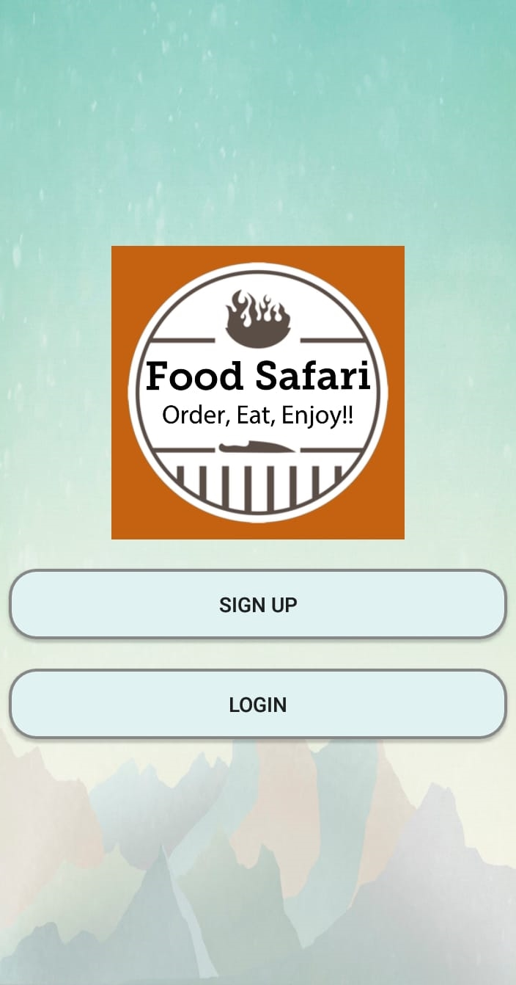
Home Page
Starting screen
Contains login or signup buttons

Slide 6
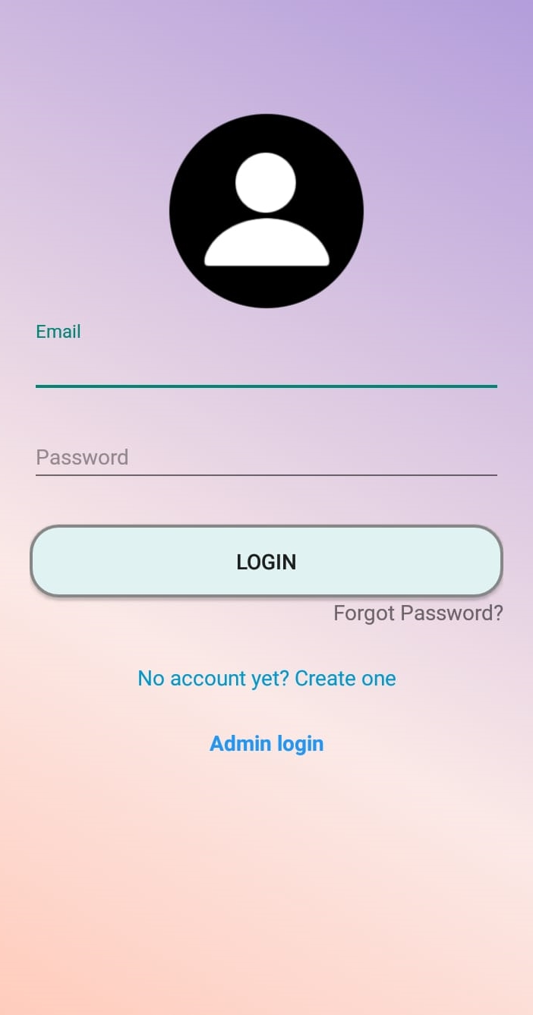
Login
User able to:
  Enter their credentials for login
  Create a new account
  Forgot password

Slide 7
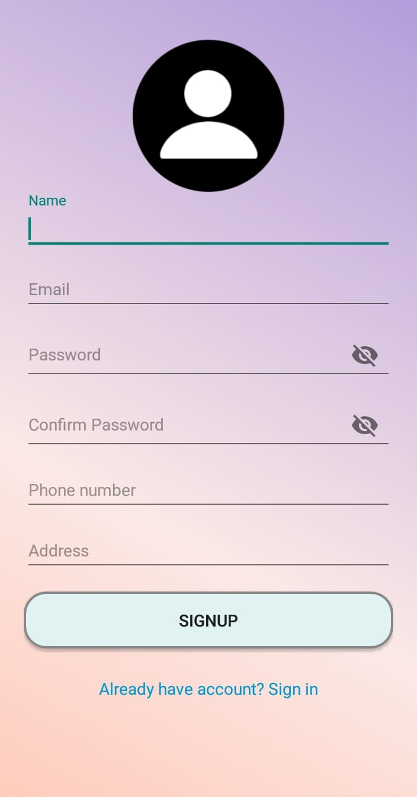
Signup
Fill the details
One email address per account
Performs validation
Able to autofill text

Slide 8
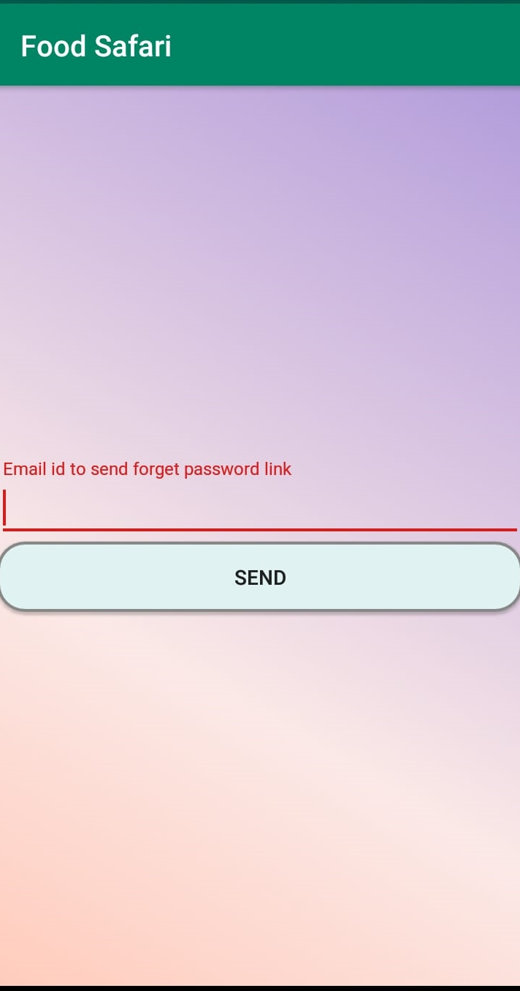
Forgot Password
Able to reset the password
Password reset link is sent registered email address

Slide 9
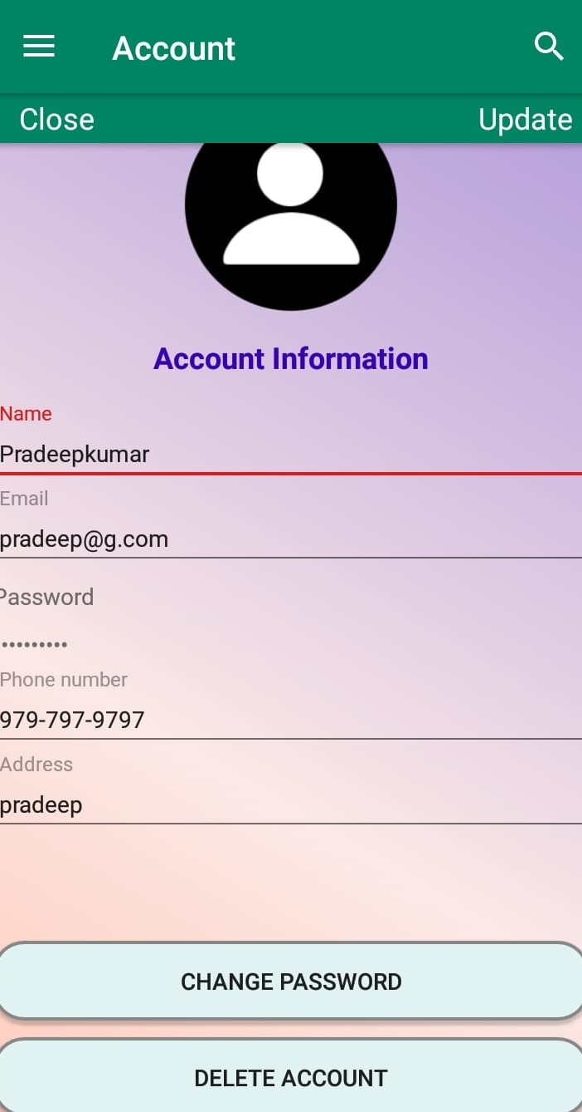
User Profile
User can modify the details
Shows the user information
Performs validation for updating details

Slide 10
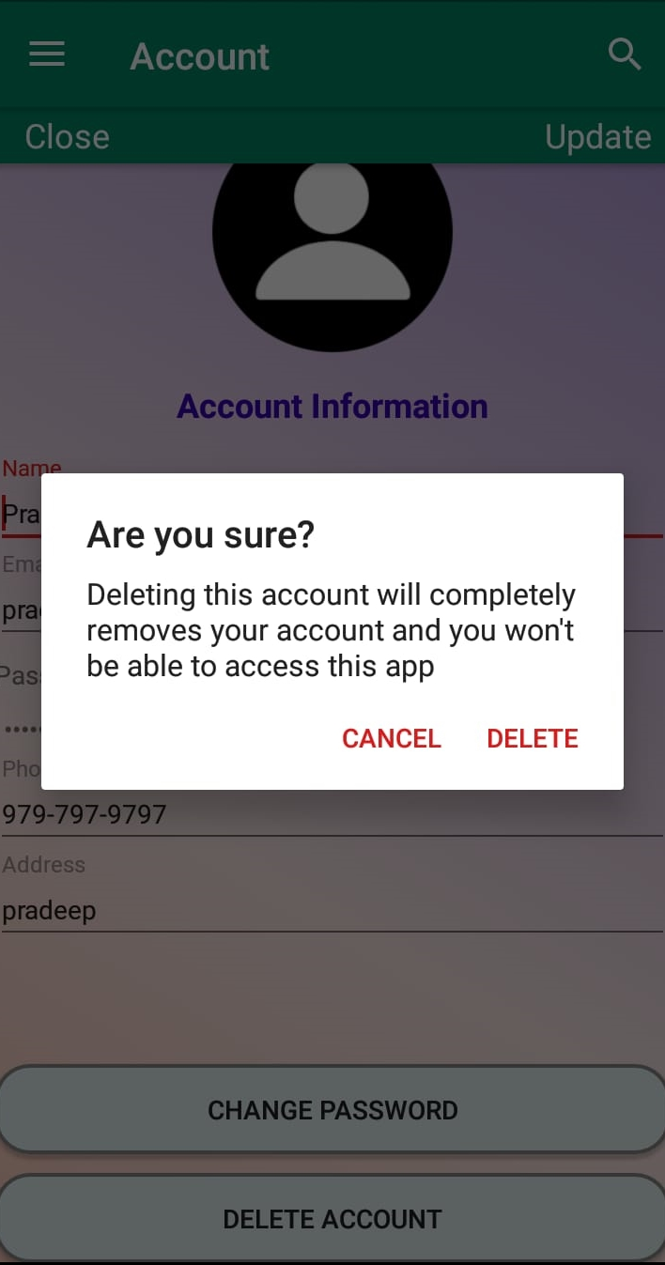
Deleting Account
User can delete his account using delete button
Opens dialog box with two options either delete or cancel
Able to manage user from database
Can disable, delete

Slide 11
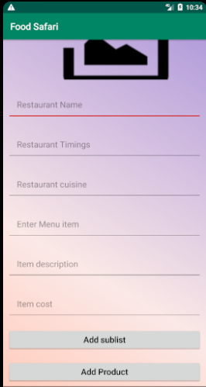
Admin Account
Restaurants and their menu items can be updated.

Slide 12
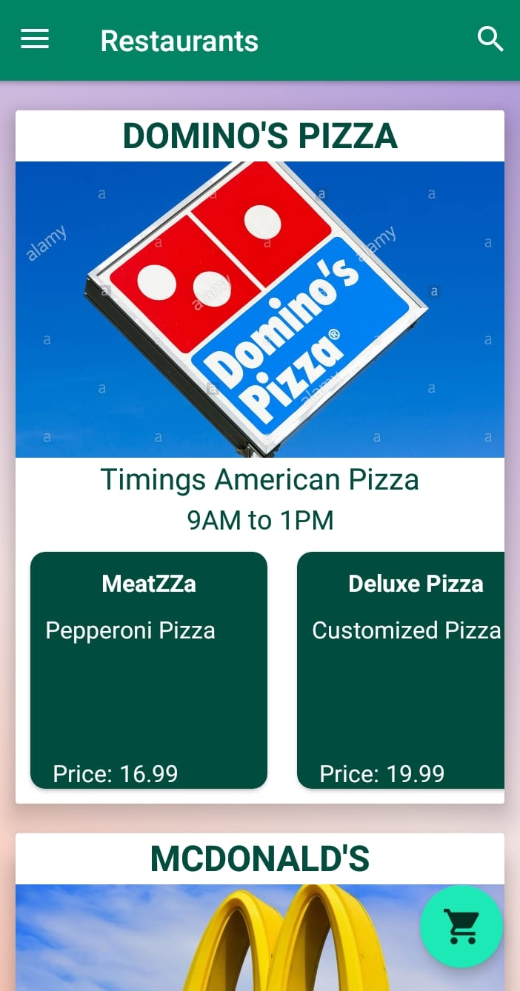
Restaurants
Registered restaurants are displayed in our app

Slide 13
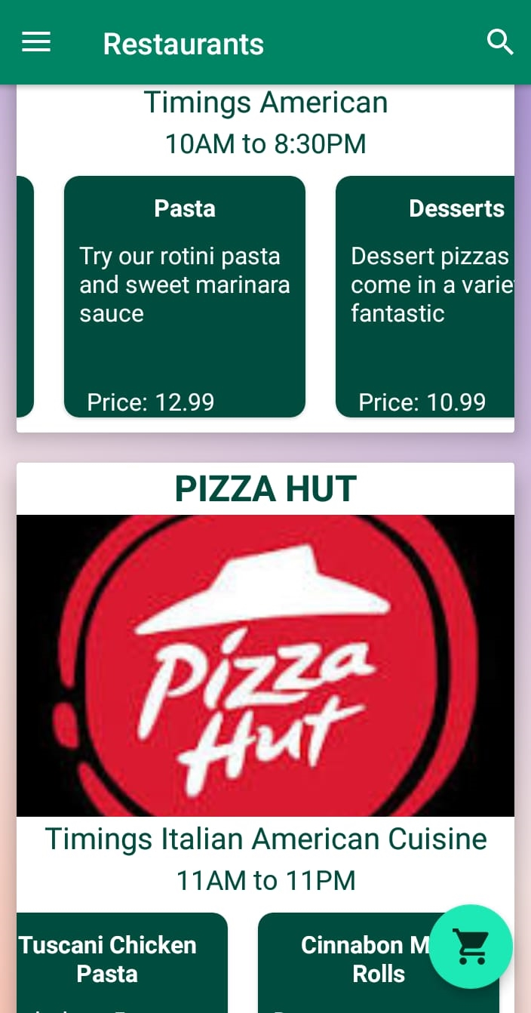
Menu
Menus of the restaurants
Raghavendar Reddy

Slide 14
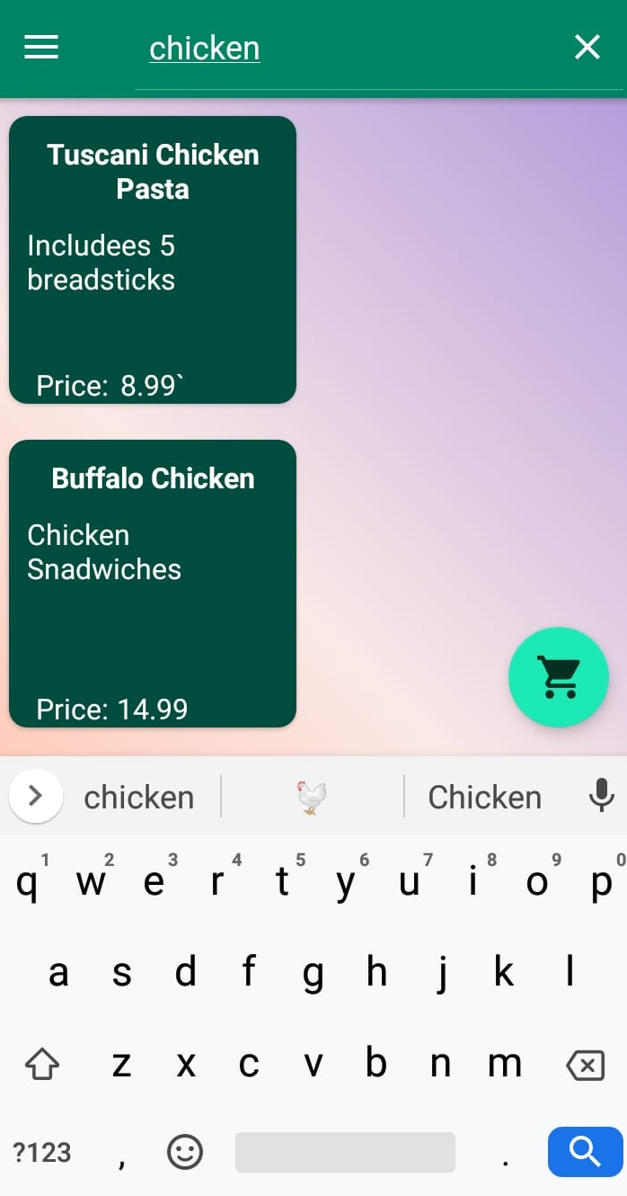
Searching Menu
User can search for menu

Slide 15
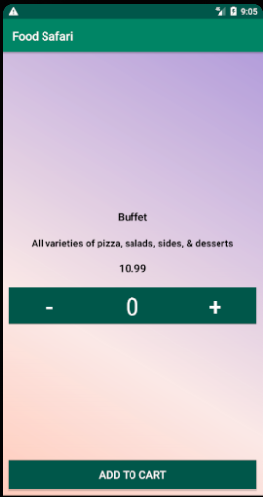
Add To Cart
Shows details about the food item.
Quantity required can be specified.

Slide 16
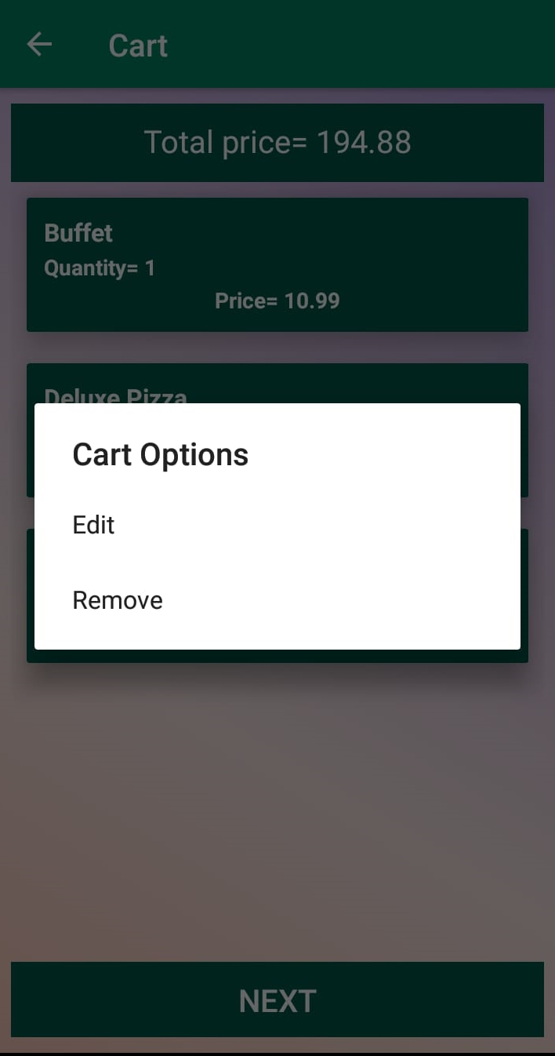
View/Edit Cart
Retrieve order details from Firebase
View all the orders
Each Order is displayed as card
Each card consists of name, price and quantity
Calculates total price

Slide 17
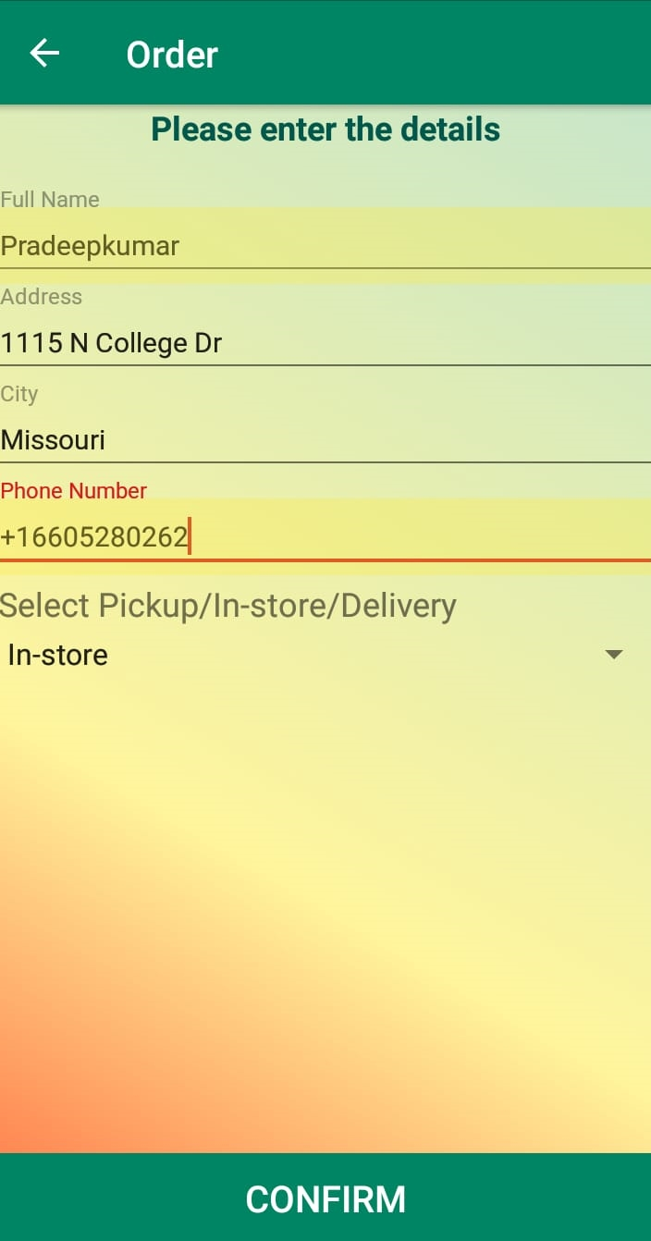
Placing Order
Shipment details of user
Order type:
  Pickup
  In-store
  Delivery

Slide 18
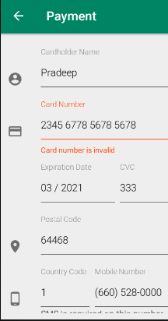
Payment
Able to pay via credit or debit card
Used Development mode

Slide 19
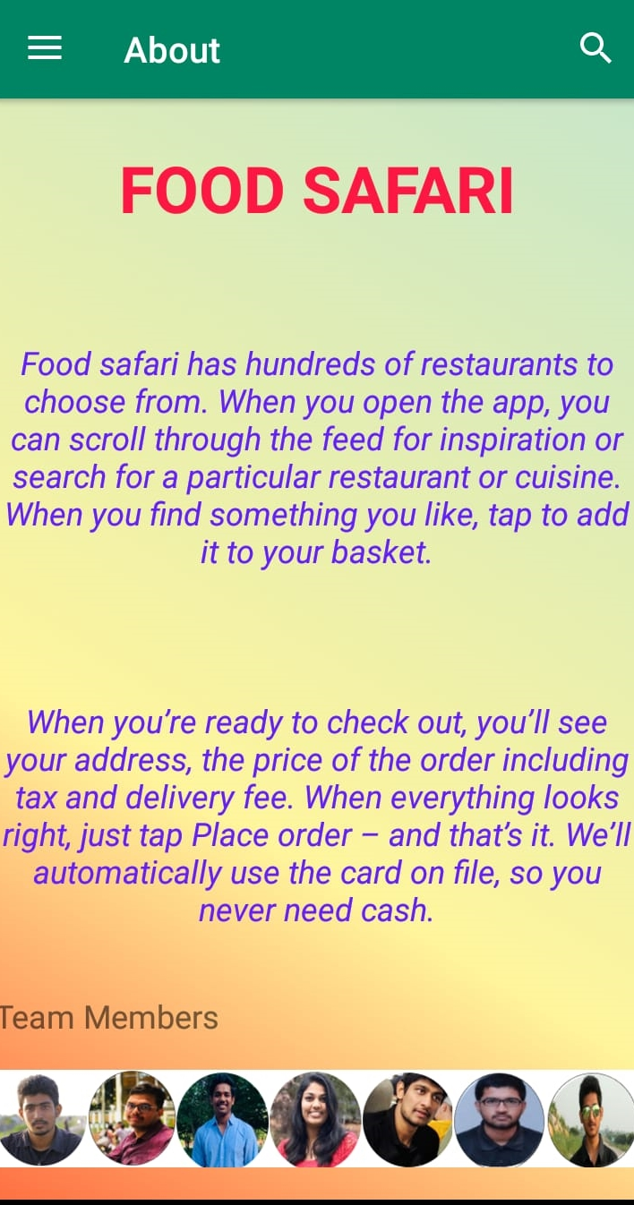
About Us
How it works:
  Browse
  Order
Our Values:
  Customer comes first
  Strive for excellence
  Be honest
  Be humble
  Always be curious and always be learning

Slide 20
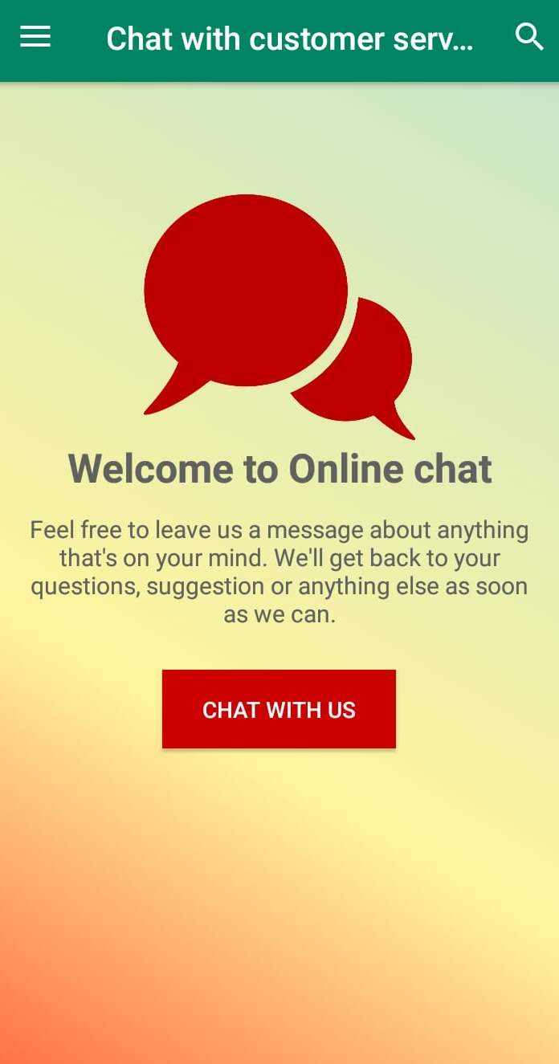
Contact Us
Chat with us:
  Giving feedback
  Information about application

Slide 21
Demo

Slide 22
Conclusion
Food safari is an android application which is user friendly, quick support using online chat and easy navigation.

Slide 23
Thank you

